Slide 1

Presentation Materials Created by Mimetics Inc.
Free use by anyone for non-commercial purposes
Copyrights, Trademarks and other Registered Marks the Property of their Owners

Slide 2
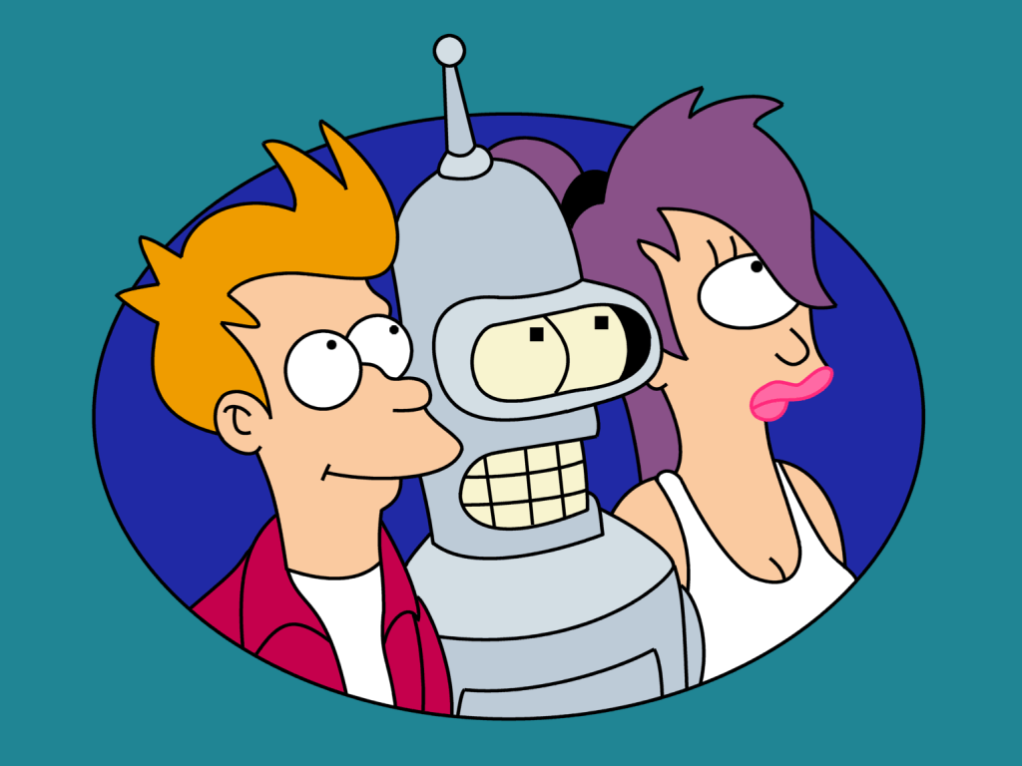
Grade 6 – Scratch 4
Robot Sensors
Notes:
We want to introduce the Jade Robot and it’s Tools in more detail along with our action plans for it.
It’s interesting, but it’s easy to criticize something when it’s done (especially when you have experience) – a *LOT* more difficult getting it right from the start. Also, preparing this presentation was a great way to review and think about what we should be doing.

Slide 3
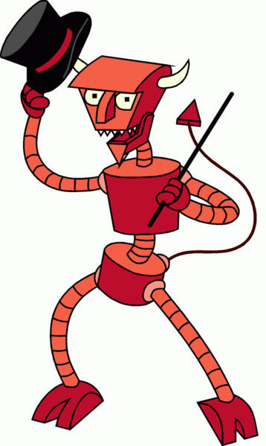
Recap
Where are the steps for creating a program?
What is the program structure?
What are the Sensors in the Jade Robot?
Notes:
Can Demo Jade Scratch if people are interested. In doing this product I’ve had a few interesting discoveries – one was going with a simpler programming language actually has a *LOT* of value for an expert like myself.

Slide 4
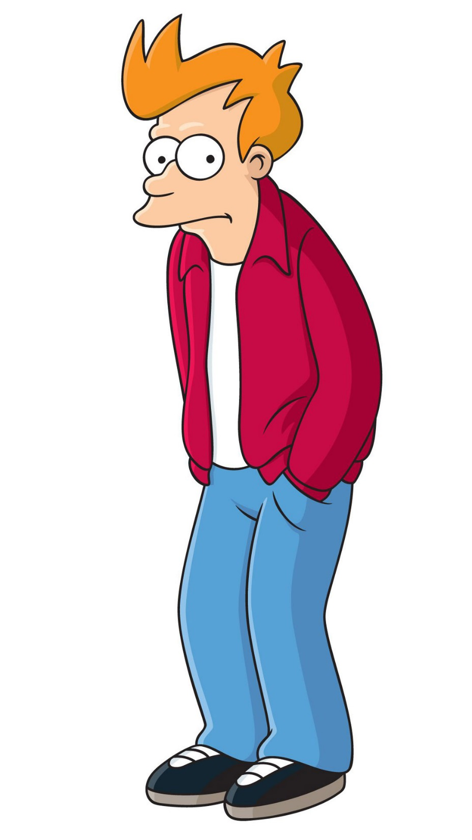
Creating a Program
Get Requirements
Break Requirements into Parts
For Each Part, List Statement Types Needed
Create a Sequence of Statements
Test Statements for Each Part
Work in Sequence and Build Up the Program as the Sum of the Parts
Test Final Program to Requirements
Celebrate!!!
Notes:
Can Demo Jade Scratch if people are interested. In doing this product I’ve had a few interesting discoveries – one was going with a simpler programming language actually has a *LOT* of value for an expert like myself.

Slide 5
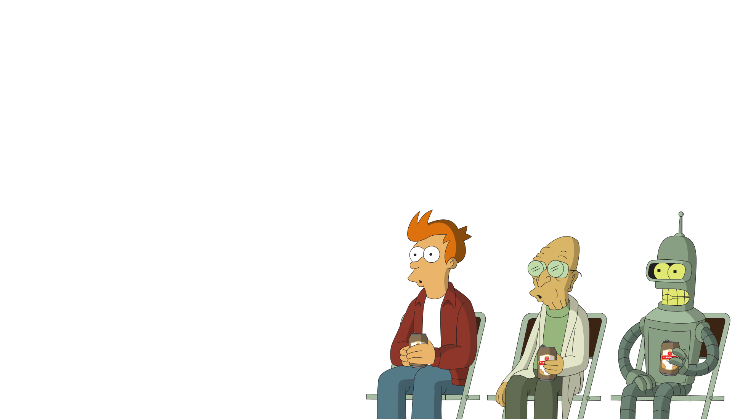
Robot Program Structure
Initialize Robot
Get Input
Process
Repeat (Loop)
Output Processed Inputs
Shutdown Robot
(Stop)
Notes:
Can Demo Jade Scratch if people are interested. In doing this product I’ve had a few interesting discoveries – one was going with a simpler programming language actually has a *LOT* of value for an expert like myself.

Slide 6
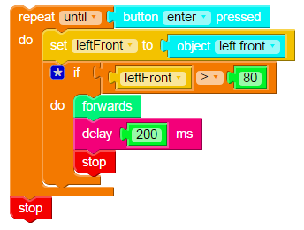
Simple Robot Program
No Initialization
Loop
Get Inputs
Process Inputs
Output Processed Inputs
Shutdown Robot
Notes:
Can Demo Jade Scratch if people are interested. In doing this product I’ve had a few interesting discoveries – one was going with a simpler programming language actually has a *LOT* of value for an expert like myself.

Slide 7
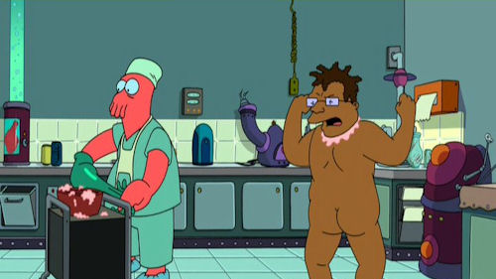
What to do when your Program Doesn’t Work
Notes:
Can Demo Jade Scratch if people are interested. In doing this product I’ve had a few interesting discoveries – one was going with a simpler programming language actually has a *LOT* of value for an expert like myself.

Slide 8

Steps to find a problem
Check Spelling/Statements
Single Step through the Program
Add Display Updates and LED Outputs to Track Progress
Isolate small Parts of the Program and Test Operation
Notes:
Can Demo Jade Scratch if people are interested. In doing this product I’ve had a few interesting discoveries – one was going with a simpler programming language actually has a *LOT* of value for an expert like myself.

Slide 9
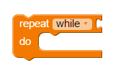
Repeat “while”/”until” Loop
Repeat WHILE Value is Not Zero
Repeat UNTIL Value is Not Zero
⬅ WHILE/UNTIL Value
Statements inside
Loop
Notes:
Can Demo Jade Scratch if people are interested. In doing this product I’ve had a few interesting discoveries – one was going with a simpler programming language actually has a *LOT* of value for an expert like myself.

Slide 10
Sensors

Slide 11
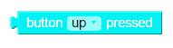
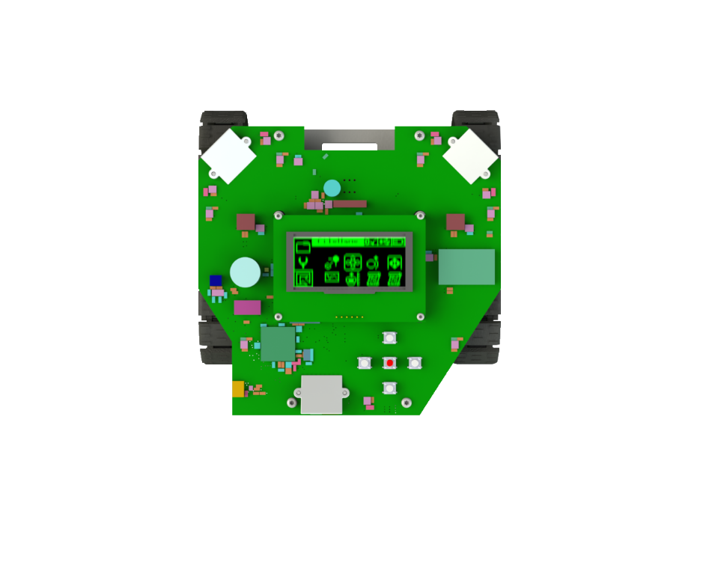
5 Buttons
Return Values:
0 – Not Pressed
Not 0 – Pressed
Top
Left
Right
Bottom
Red Button is “Enter”
Notes:
Can Demo Jade Scratch if people are interested. In doing this product I’ve had a few interesting discoveries – one was going with a simpler programming language actually has a *LOT* of value for an expert like myself.

Slide 12
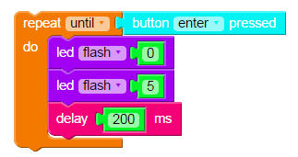
“butTest1”
Notes:
Can Demo Jade Scratch if people are interested. In doing this product I’ve had a few interesting discoveries – one was going with a simpler programming language actually has a *LOT* of value for an expert like myself.

Slide 13


Sensor Values
Sensor Values are between 0 and 100
Notes:
Can Demo Jade Scratch if people are interested. In doing this product I’ve had a few interesting discoveries – one was going with a simpler programming language actually has a *LOT* of value for an expert like myself.

Slide 14
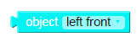
5 Object Sensors
left front
left side
Return Values:
100 – Far Away
In Between/Distance
0 – Very Close
right front
right side
Left Front
Right Front
Left Side
Right Side
rear
Rear
Notes:
Can Demo Jade Scratch if people are interested. In doing this product I’ve had a few interesting discoveries – one was going with a simpler programming language actually has a *LOT* of value for an expert like myself.

Slide 15
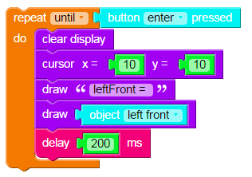
“objTest1”
Notes:
Can Demo Jade Scratch if people are interested. In doing this product I’ve had a few interesting discoveries – one was going with a simpler programming language actually has a *LOT* of value for an expert like myself.

Slide 16
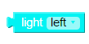
3 Light Sensors
Return Values:
100 – Very Bright
In Between/Distance
0 – Very Dark
Right
Left
Rear
Notes:
Can Demo Jade Scratch if people are interested. In doing this product I’ve had a few interesting discoveries – one was going with a simpler programming language actually has a *LOT* of value for an expert like myself.

Slide 17
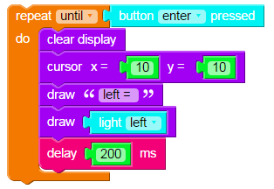
“lytTest1”
Notes:
Can Demo Jade Scratch if people are interested. In doing this product I’ve had a few interesting discoveries – one was going with a simpler programming language actually has a *LOT* of value for an expert like myself.

Slide 18
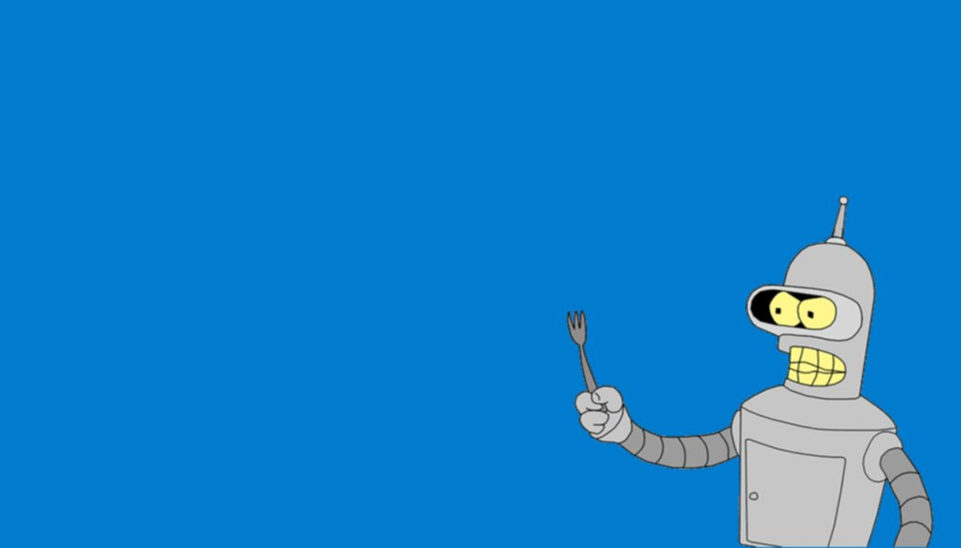
Challenge: Display all 5 Object Sensors
Organize Data as:
Left Front Right Front
Left Side Right Side
Rear
“lytTest1”
Notes:
Can Demo Jade Scratch if people are interested. In doing this product I’ve had a few interesting discoveries – one was going with a simpler programming language actually has a *LOT* of value for an expert like myself.

Slide 19
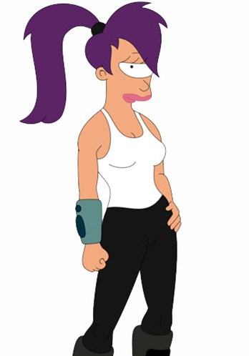
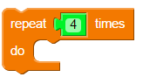
Repeat # Loop
Statements Inside Loop Statement Are Repeated
Four Times
Notes:
Can Demo Jade Scratch if people are interested. In doing this product I’ve had a few interesting discoveries – one was going with a simpler programming language actually has a *LOT* of value for an expert like myself.

Slide 20
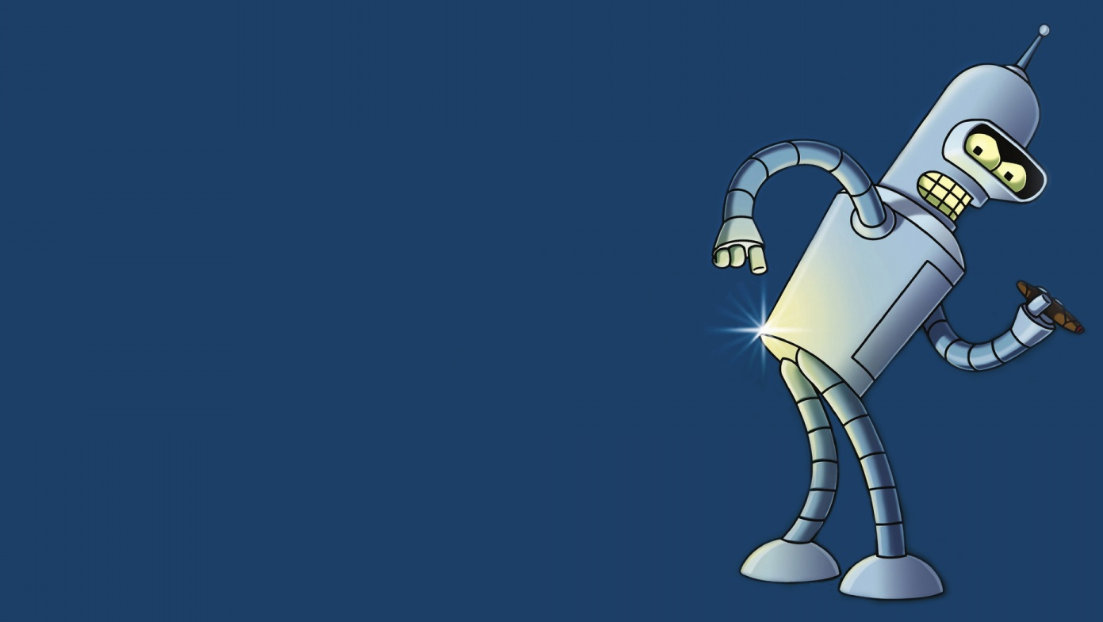
Challenge: Using Repeat # Loop Make the Robot Draw a Repeating Pattern
Get Paper and Marker and
Draw the Pattern
Notes:
Can Demo Jade Scratch if people are interested. In doing this product I’ve had a few interesting discoveries – one was going with a simpler programming language actually has a *LOT* of value for an expert like myself.

